Slide 1

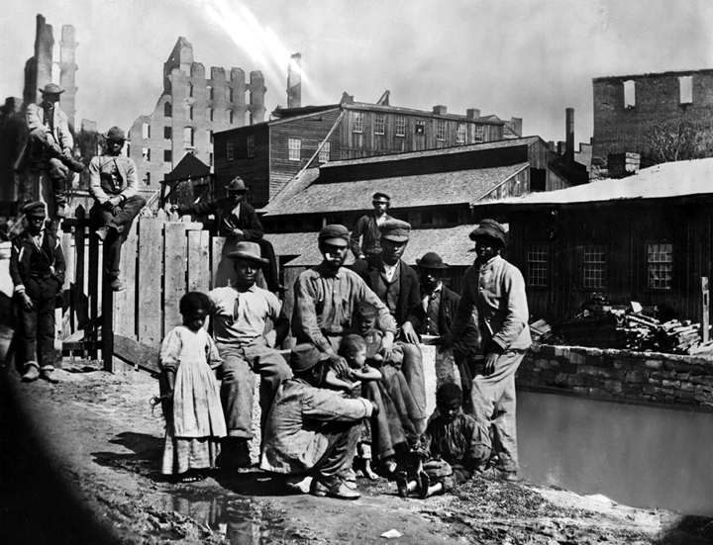
Reconstruction,
1865–1877
The President and Congress fight over how to rebuild the South. Reconstruction
has a major impact on African Americans and Southerners.
Freed African Americans in a Southern town shortly after the Civil War (about 1860s).
NEXT

Slide 2
Reconstruction,
1865–1877
SECTION 1
Rebuilding the Union
SECTION 2
Reconstruction and Daily Life
SECTION 3
End of Reconstruction
NEXT

Slide 3

Section 1
Rebuilding the Union
During Reconstruction, the president and Congress fight over how to rebuild the
South.
NEXT

Slide 4
SECTION
Rebuilding the Union
1
Reconstruction Begins
• Reconstruction—process of readmitting Confederate states into Union
• President Lincoln establishes the Freedmen’s
Bureau:
- sets up schools, hospitals for African Americans
- distributes clothes, food, fuel for African
Americans
• After Lincoln’s death, vice-president Andrew Johnson becomes president
• Insists states ratify 13th Amendment, pardons most white Southerners
NEXT

Slide 5
SECTION
1
Rebuilding Brings Conflict
• Southern states set up governments similar to old ones
• Pass laws known as black codes—limits freedom of former slaves
• Congress refuses to seat representatives from South (1865)
• Sets up committee to study South, decide about Congress representation
• Radical Republicans want federal government active in remaking South
NEXT

Slide 6
SECTION
1
The Civil Rights Act
• Congress passes bill, civil rights—rights given to all citizens
• Civil Rights Act of 1866 declares:
- all persons born in the U.S. (except Native
Americans) are citizens
- all citizens are entitled to equal rights regardless
of race
• President Johnson vetoes bill
• Congress overrides veto, bill becomes law
NEXT

Slide 7
SECTION
1
The Fourteenth Amendment
• Congress proposes the Fourteenth Amendment
(1866):
- all people born in U.S. are citizens, have equal
rights
- states preventing black suffrage will lose
representation in Congress
• President Johnson, most southern states refuse to support amendment
Continued . . .
NEXT

Slide 8
SECTION
1
Continued The Fourteenth Amendment
• Reconstruction Acts of 1867 divides South into 5 districts
Map
• Law sets down requirements for Southern states
to reenter Union:
- give vote to all adult men, including African
Americans
- ratify the Fourteenth Amendment
NEXT

Slide 9
SECTION
1
The New Southern Governments
• Southern voters choose delegates to draft new state constitutions (1867)
• Most delegates are Republicans, poor white farmers—scalawags
• Republican delegates also include African Americans and carpetbaggers
• Carpetbaggers—Northerners who come to the South after the war
• All Southern states approve new constitutions, let back in Union
• During Reconstruction, many African Americans in state, U.S. government
NEXT

Slide 10
SECTION
1
Johnson Is Impeached
• President Johnson fights against many reforms during Reconstruction
• Congress passes Tenure of Office Act (1867):
- president cannot fire government officials
without Senate’s approval
• Johnson fires secretary of war, Edwin Stanton, (February 1868)
• Johnson is impeached, acquitted
NEXT

Slide 11
Section 2
Reconstruction and
Daily Life
As the South rebuilds, millions of newly freed African Americans work to improve their lives.
NEXT

Slide 12
SECTION
Reconstruction and Daily Life
2
Responding to Freedom
• African Americans leave plantations, look for economic opportunities
• Some return to where they were born, others travel because they could
• Many search for family members separated from them during slavery
• Freedom allows African Americans to strengthen family ties
NEXT

Slide 13
SECTION
2
Starting Schools
• African Americans go to freedmen’s schools to learn to read, write
• Schools are paid for by:
- African American groups
- federal government
- private groups
• Many white Southerners work against
African-American education
• White racists kill teachers, burn freedmen’s schools in South
NEXT

Slide 14
SECTION
2
40 Acres and a Mule
• Freed people want to own land, gain economic independence
• Some freedmen receive 40 acres and a mule, most never receive land
• Radical Republican leaders push for land reform to aid freedmen
• Congress does not pass land-reform plan.
NEXT

Slide 15
SECTION
2
The Contract System
• Without property, many African Americans return to work on plantations
• They return not as slaves, but as wage earners
• Planters desperately need workers to raise cotton
• African Americans use contract system—choose best contract offers
• Workers earn low wages, planters cannot split up worker’s families
• Laws punish workers for breaking contract even if planters abuse them
NEXT

Slide 16
SECTION
2
Sharecropping and Debt
• Under Sharecropping system:
- worker rents plot of land to farm
- landowner provides tools, seed, housing
- sharecropper gives landowner a share of the crop
• Gives families without land a place to farm, landowners cheap labor
Image
Continued . . .
NEXT

Slide 17
SECTION
2
Continued Sharecropping and Debt
• Sharecroppers have to grow cash crops, buy food from local store
• Sharecroppers do not have money for goods, caught in cycle of debt
• Planters rely too much on growing cotton, hurts soil, South’s economy
• South has to import half its food
NEXT

Slide 18
SECTION
2
The Ku Klux Klan
• Many Southerners do not want African Americans to have rights
• Form Ku Klux Klan, a secret group that has two
main goals:
- restore Democratic control of the South
- keep former slaves powerless
Continued . . .
NEXT

Slide 19
SECTION
2
Continued The Ku Klux Klan
• Klansmen dress in white robes, hoods, attack African Americans
• Klan also attacked white Republicans
• Lynch some victims, killing them without a trial for a supposed crime
• Klan’s victims have little protection from the law
• Terrorism keeps Republicans from polls, Democrats increase power
NEXT

Slide 20
Section 3
End of Reconstruction
As white Southerners regain power, Reconstruction ends, as did black advances
toward equality.
NEXT

Slide 21
SECTION
End of Reconstruction
3
The Election of Grant
• Republican Ulysses S. Grant wins the U.S. presidency (1868)
Image
• African American vote helps to elect Grant
NEXT

Slide 22
SECTION
3
The Fifteenth Amendment
• Congress passes Fifteenth Amendment (1870):
- cannot stop citizen from voting because of race,
previous servitude
Image
• Does not apply to women, many suffragists protest
NEXT

Slide 23
SECTION
3
Grant Fights the Klan
• Congress passes President Grant’s tough,
anti-Klan law
• Many Klansmen are arrested, attacks on African-American voters decline
• 1872 presidential election is fair, peaceful in the South
• Grant wins a second term
NEXT

Slide 24
SECTION
3
Scandal and Panic Weaken Republicans
• Some of Grant’s advisors take bribes, scandal angers Republicans
• Some Republicans form separate party, weaken Republican party
• Panic of 1873—banks across U.S. close, stock market crashes
Image
• Causes economic depression, railroad industry, farmers suffer
• Many blame Republicans, interest in Reconstruction lessens
NEXT

Slide 25
SECTION
3
Supreme Court Reversals
• In U.S. v. Cruikshank case (1876), Supreme Court
rules:
- only state governments punish people who violate
black civil rights
• In U.S. v. Reese (1876), Supreme Court:
- states could prevent African Americans from
voting
• Court decisions weaken Reconstruction
NEXT

Slide 26
SECTION
3
Reconstruction Ends
• 1876 presidential election both Democrats, Republicans claim victory
• Republicans, Democrats agree to Compromise of
1877:
- makes Republican Rutherford B. Hayes president
- removes federal troops from South
• South, reconstruction governments collapse, Democrats return to power
NEXT

Slide 27
SECTION
3
The Legacy of Reconstruction
• Nation rebuilds, reunites, African Americans do not achieve equality
• Most African Americans still live in poverty, face violence, prejudice
• 14th, 15th amendments provide basis for later civil rights laws
Chart
• Black schools, churches begun during Reconstruction endure
NEXT

Slide 28
This is the end of the chapter presentation of
lecture notes. Click the HOME or EXIT button.
NEXT

Slide 29



Print Slide Show
1. On the File menu, select Print
2. In the pop-up menu, select Microsoft PowerPoint
If the dialog box does not include this pop-up, continue to step 4
3. In the Print what box, choose the presentation format you want to print: slides, notes, handouts, or outline
4. Click the Print button to print the PowerPoint presentation
Print Text Version
1. Click the Print Text button below; a text file will open in Adobe Acrobat
2. On the File menu, select Print
3. Click the Print button to print the entire document, or select the pages you want to print
Print Text
Print Text
BACK

